Slide 1
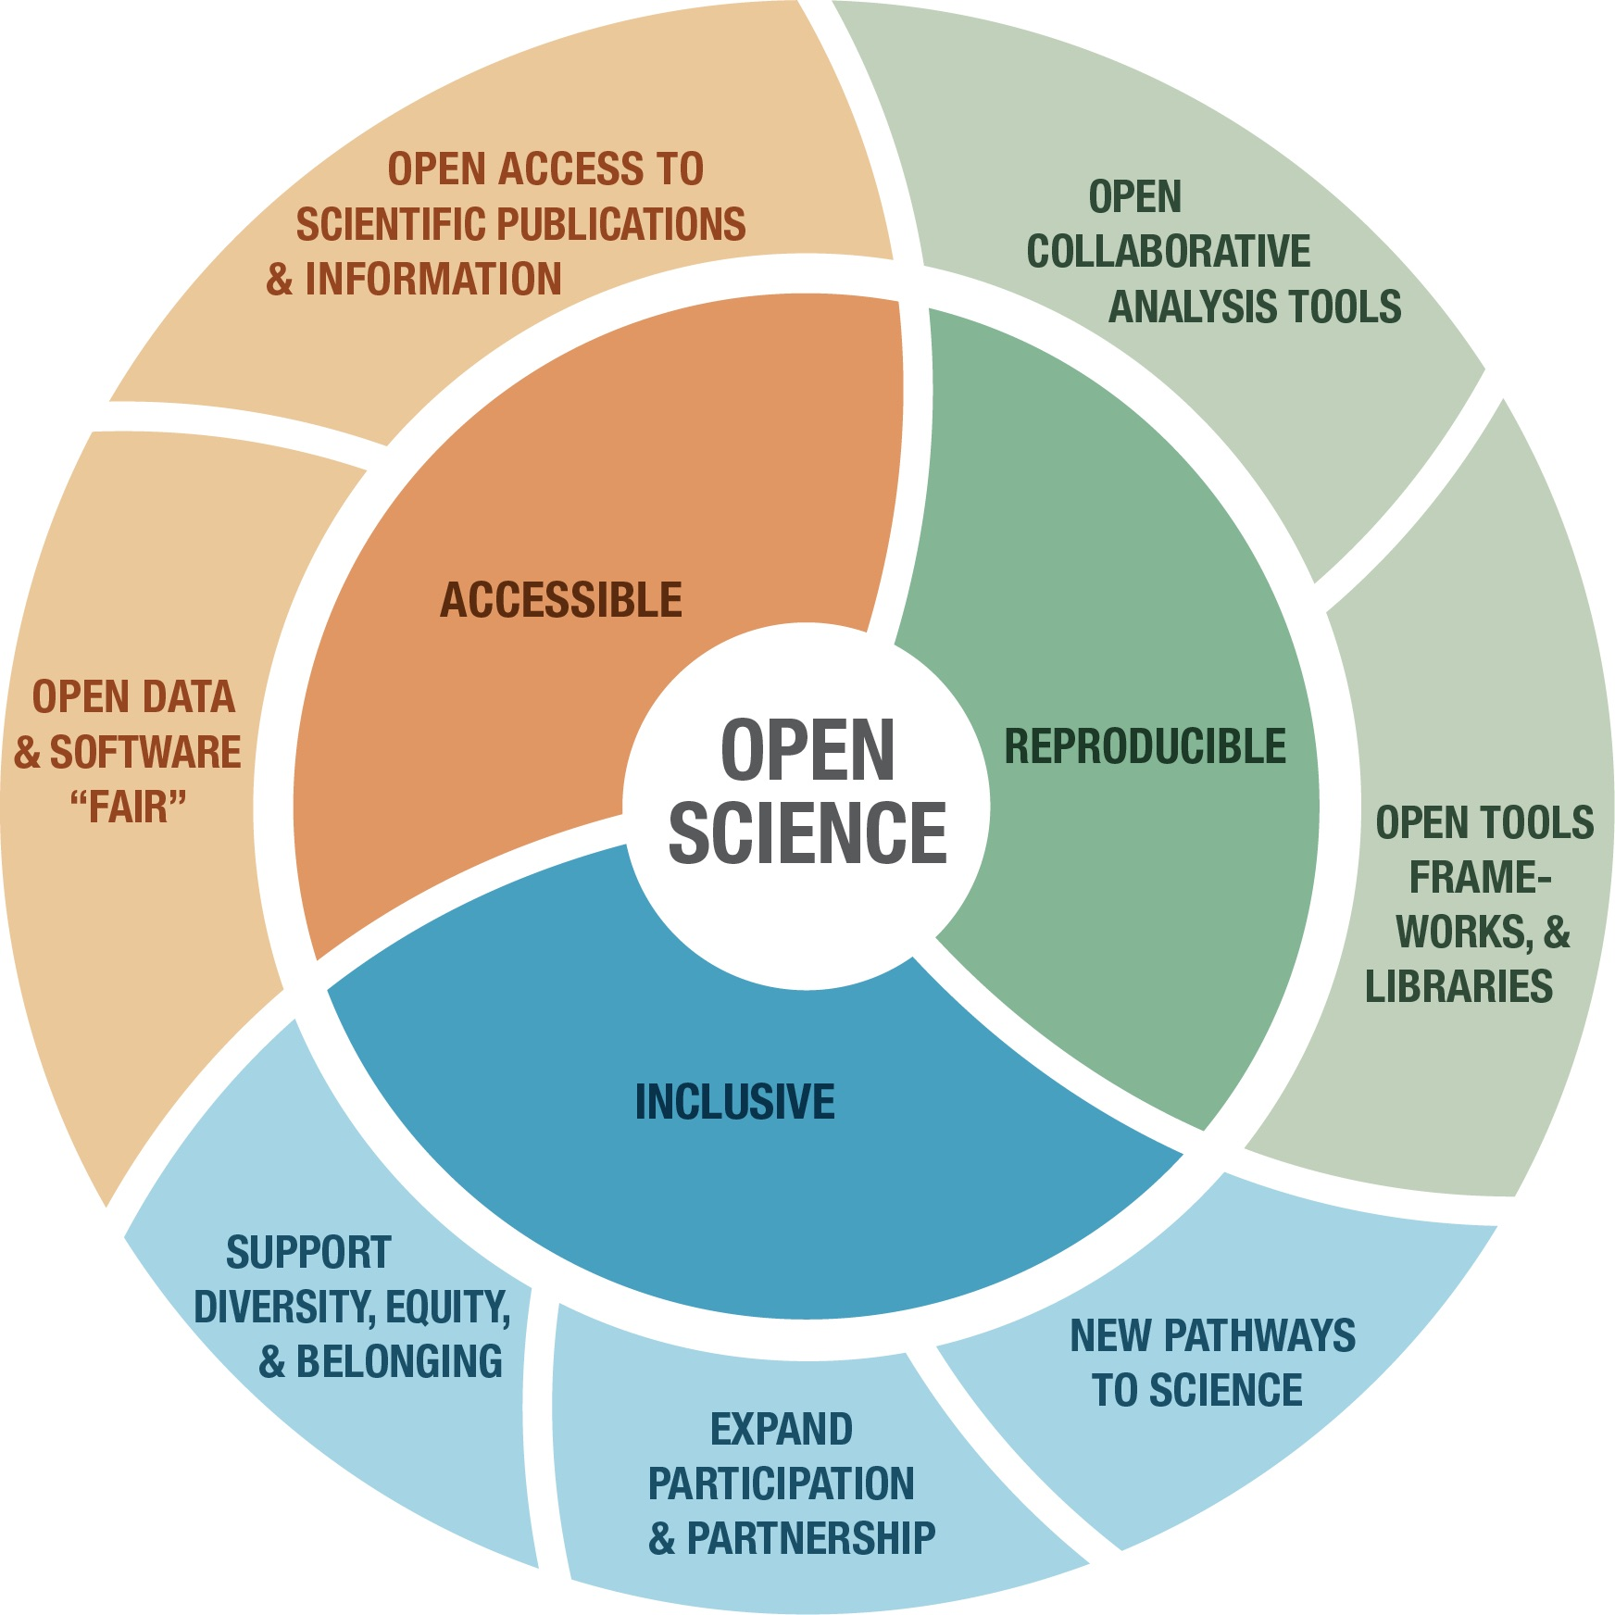
Community weather radar software and Open Science
Daniel Michelson and Max Grover
European Conference on Radar in Meteorology and Hydrology
August 28, 2022
Locarno, Switzerland

Slide 2
Outline
Open Science basics and background (bottom-up)
Open Science developments
Moving towards more Open Science practices
Disclaimer: this talk is not intended as communication of direction on how science should be conducted, nor is it intended as critique of existing practices.
Not what to science, but ideas on how to science.

Slide 3

What is Open Science in practice?
Open Data + Open Algorithms + Open Software + Open Peer Review + Open Access Publication
Thereby, science process and outputs can be:
Transparent
Reproducible
Transferrable
Collaborative
Credible!
Durable, sustainable
IMPORTANT!
No conflict between Intellectual Property Rights (IPR) and licensing.

Slide 4
NASA Transform to Open Science (TOPS) Initiative
Key components
Open meetings
Open curriculum
Open data
Open compute
Incentives for participating
Goals
Increase understanding and adoption of open science principles and techniques in our Mission and Research Communities
Accelerate major scientific discoveries through supporting the adoption of open science
Broaden participation by historically excluded communities
$40 million+ initiative
Image courtesy of NASA TOPS

Slide 5

What is Pangeo?

Slide 6
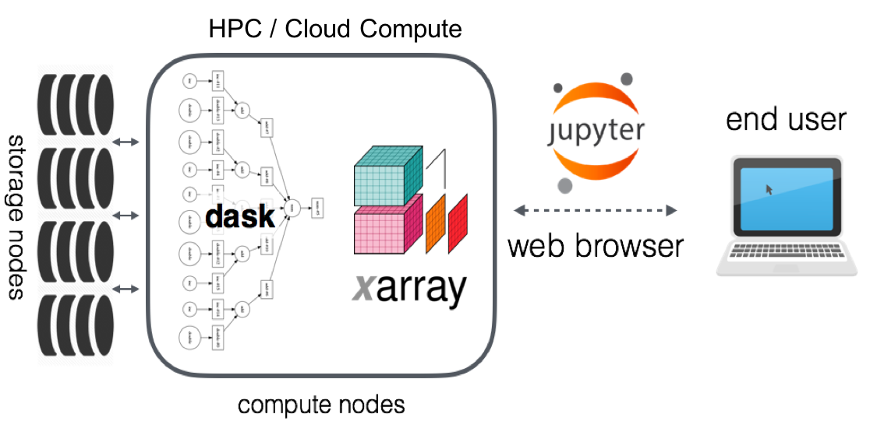
Pangeo

Slide 7
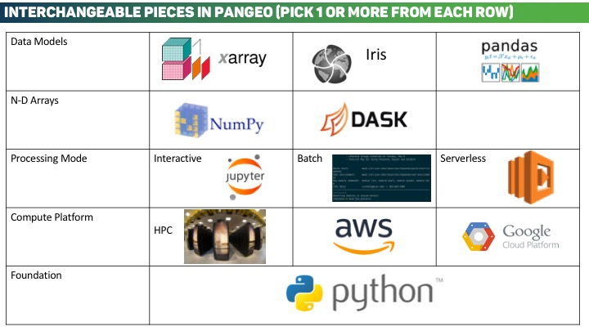
The Importance of Interoperability

Slide 8
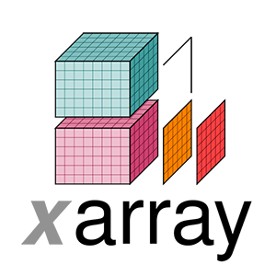



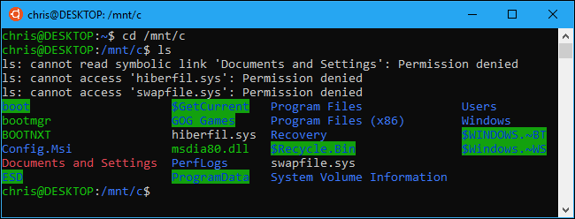
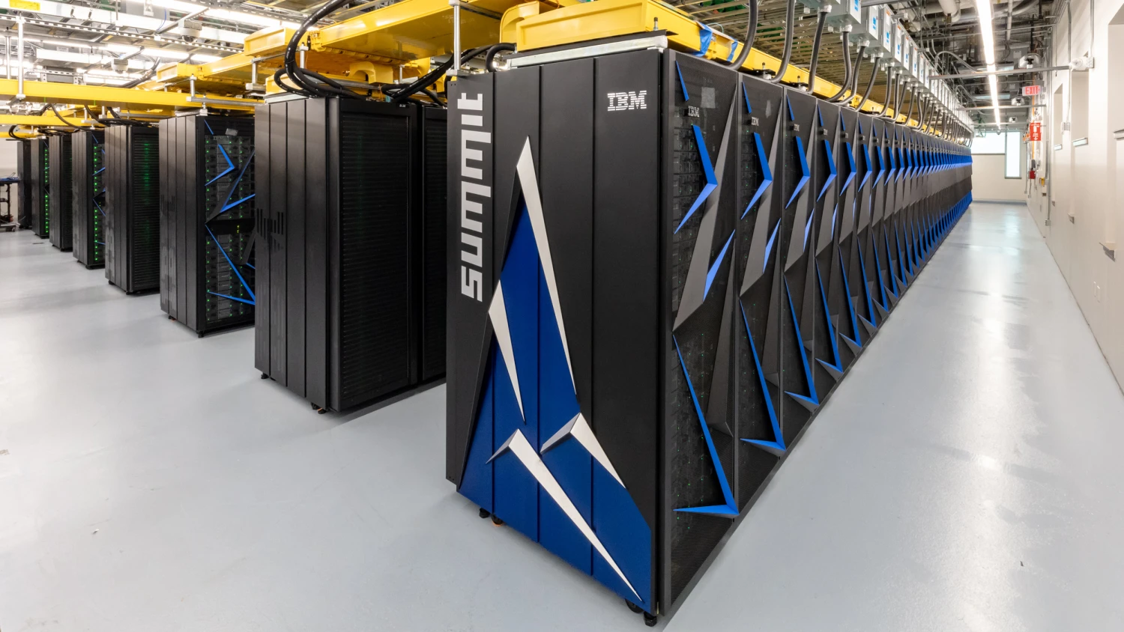

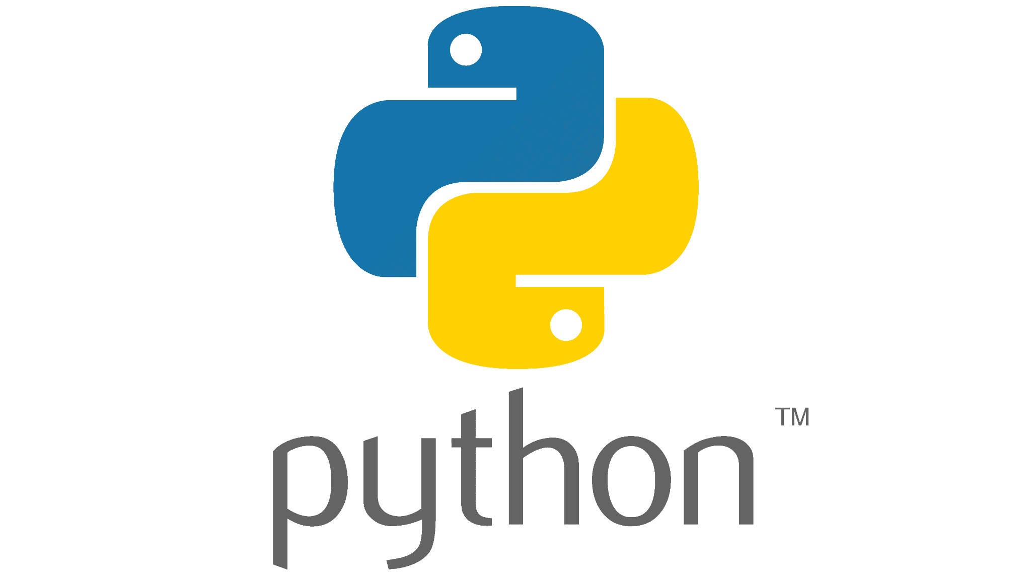

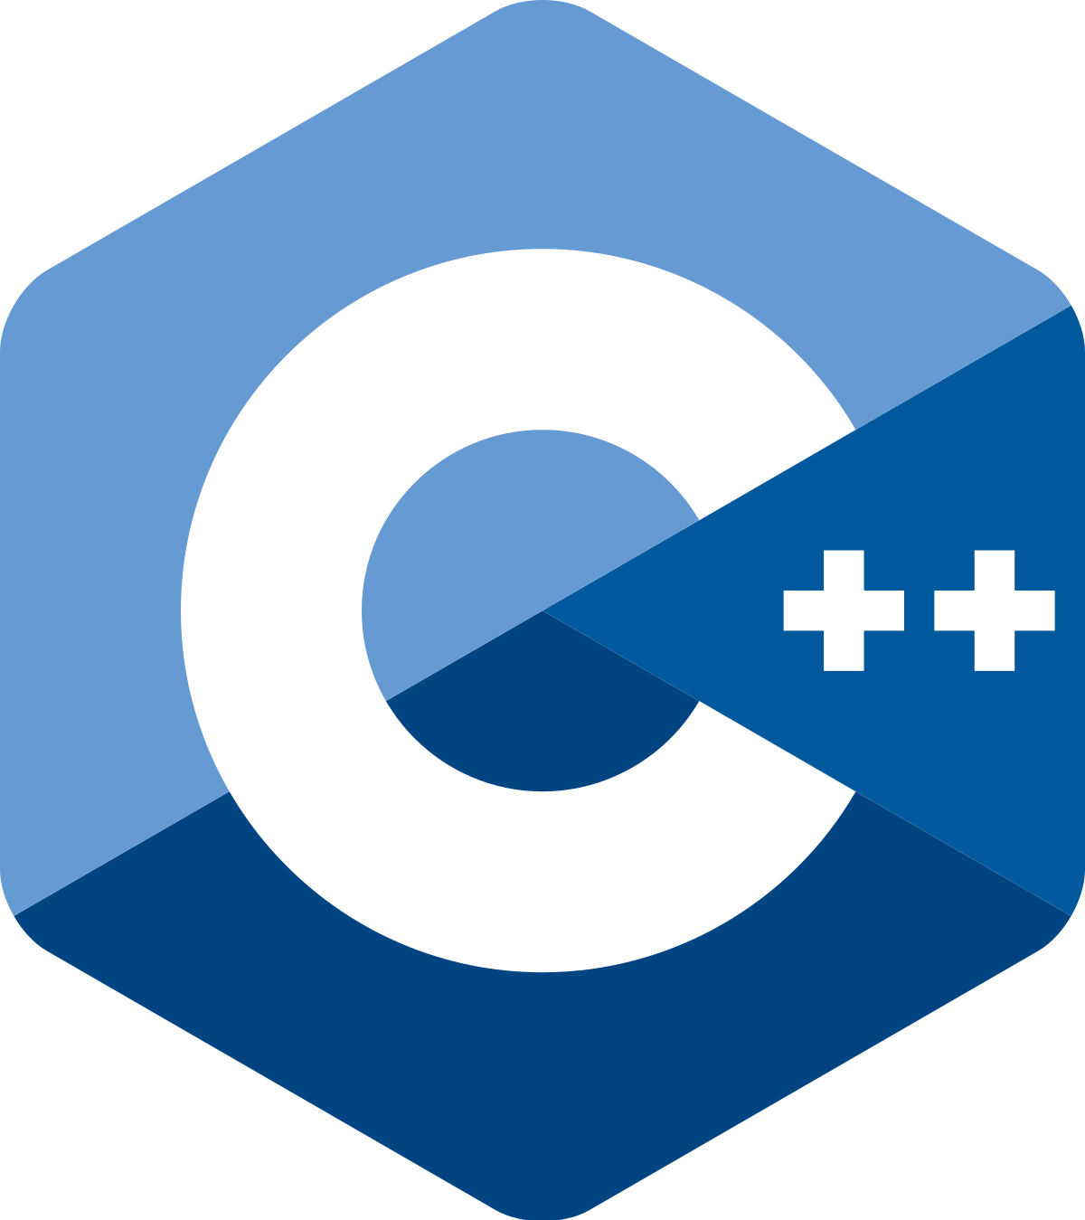
Applying this to the Open Radar Community
(Pick one or more from each row)
Data Models | PyART Radar (based on CfRadial 1.4) BALTRAD objects (based on ODIM_H5) | wradlib
N-D Arrays
Processing Mode | Interactive | Batch
Compute Platform | HPC | Cloud
Foundation + Language | Py-ART, wradlib, PyRAD | LROSE, BALTRAD

Slide 9
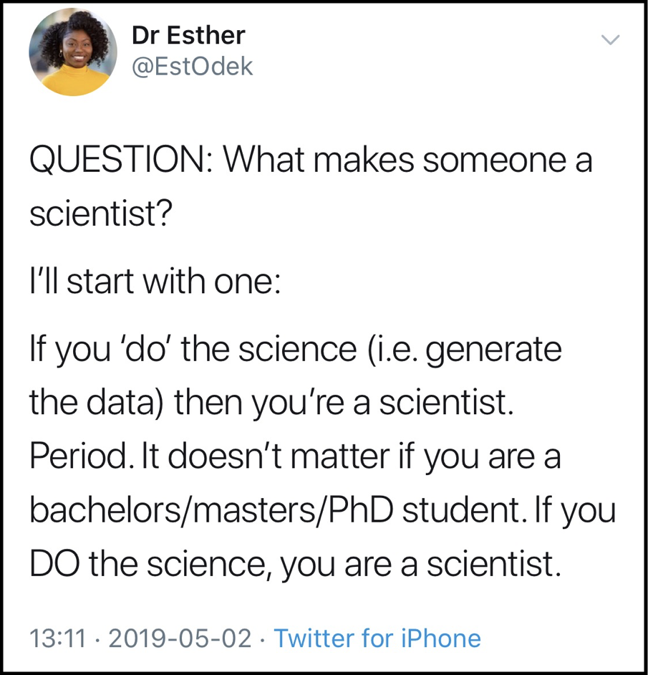
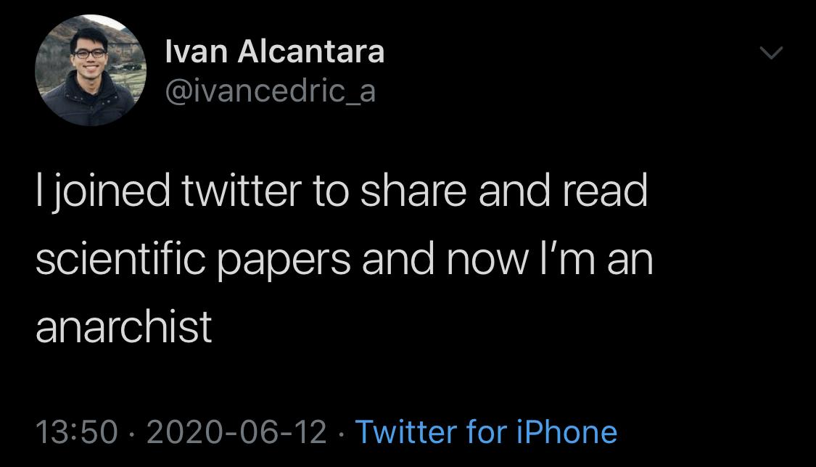
Who is a scientist?
Affects incentive structures: who can and should receive credit for publishing not only papers but also data sets and code.
Career progression, opportunity
Notes:
Important for ECCC to recognize

Slide 10
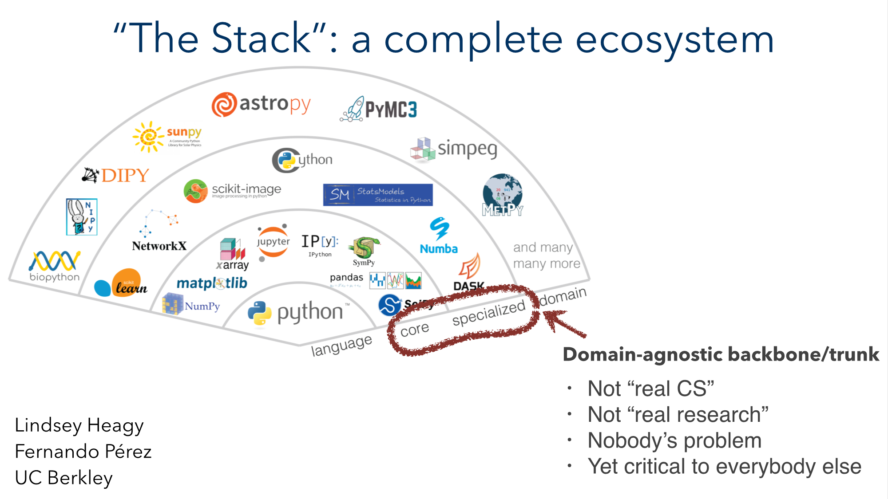

Progress made: the role of open software in science
Some solutions for some of our domain

Slide 11
Open science solutions – pro tips (1/2)
Use Git for collaborative change/version code management
GitHub: github.com
GitLab: gitlab.com
Linux virtual machine on your local computer
Cost-effective near-replication of official environments
Good for development, even while traveling
VM is the starting point, a vehicle, for creating transferrable computational environments
Today’s cloud instance is an “elaborated” VM

Slide 12
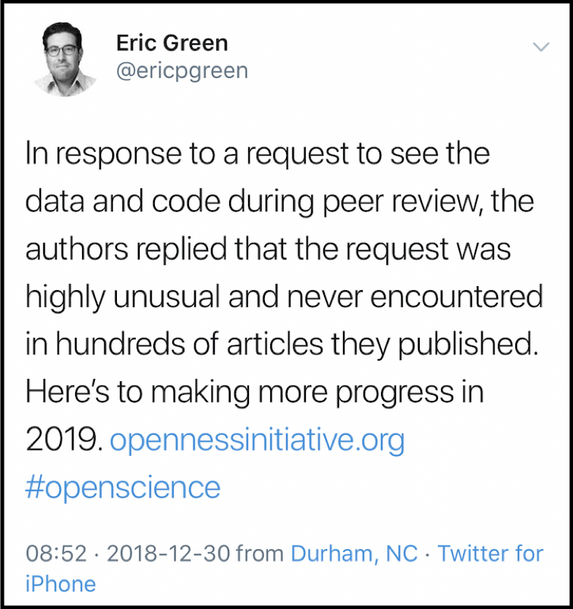
Open science solutions – pro tips (2/2)
If you have a choice, use an open programming language
Avoid proprietary algorithms like Numerical Recipes
Publish code
Publish data
Publish code & data associated with a study/paper
How? (next slides)
Publish in Open Access journals
Notes:
LICENSE?

Slide 13
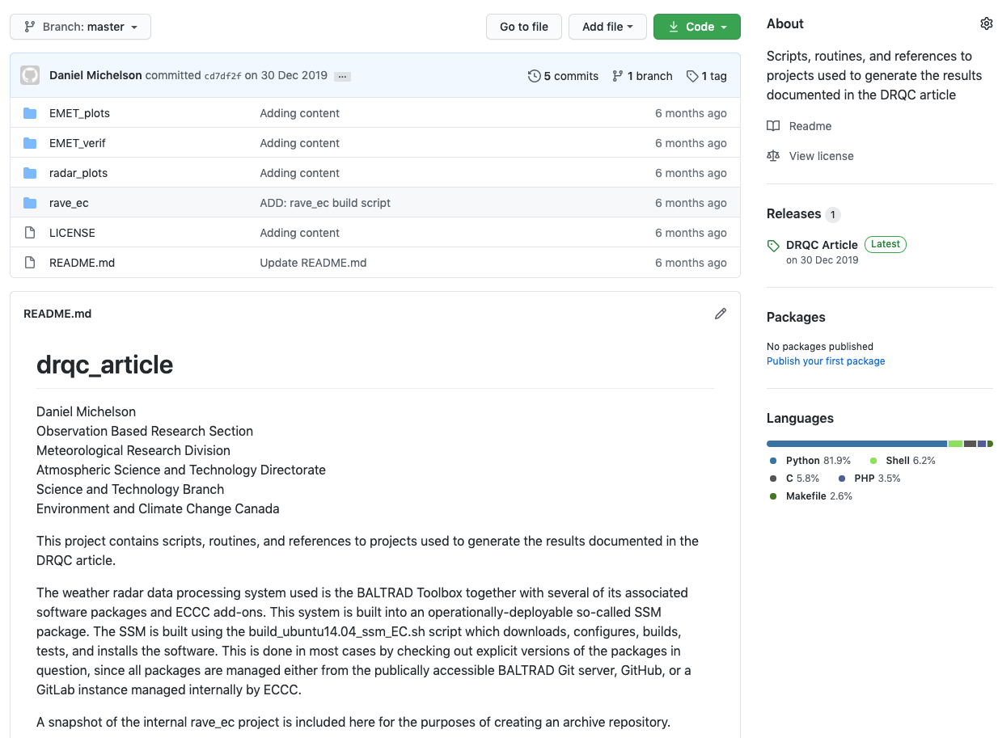
Publishing code and data for a study/paper (1/2)
Put code, data and ancillary scripts on GitHub
“Create a release” in GitHub

Slide 14
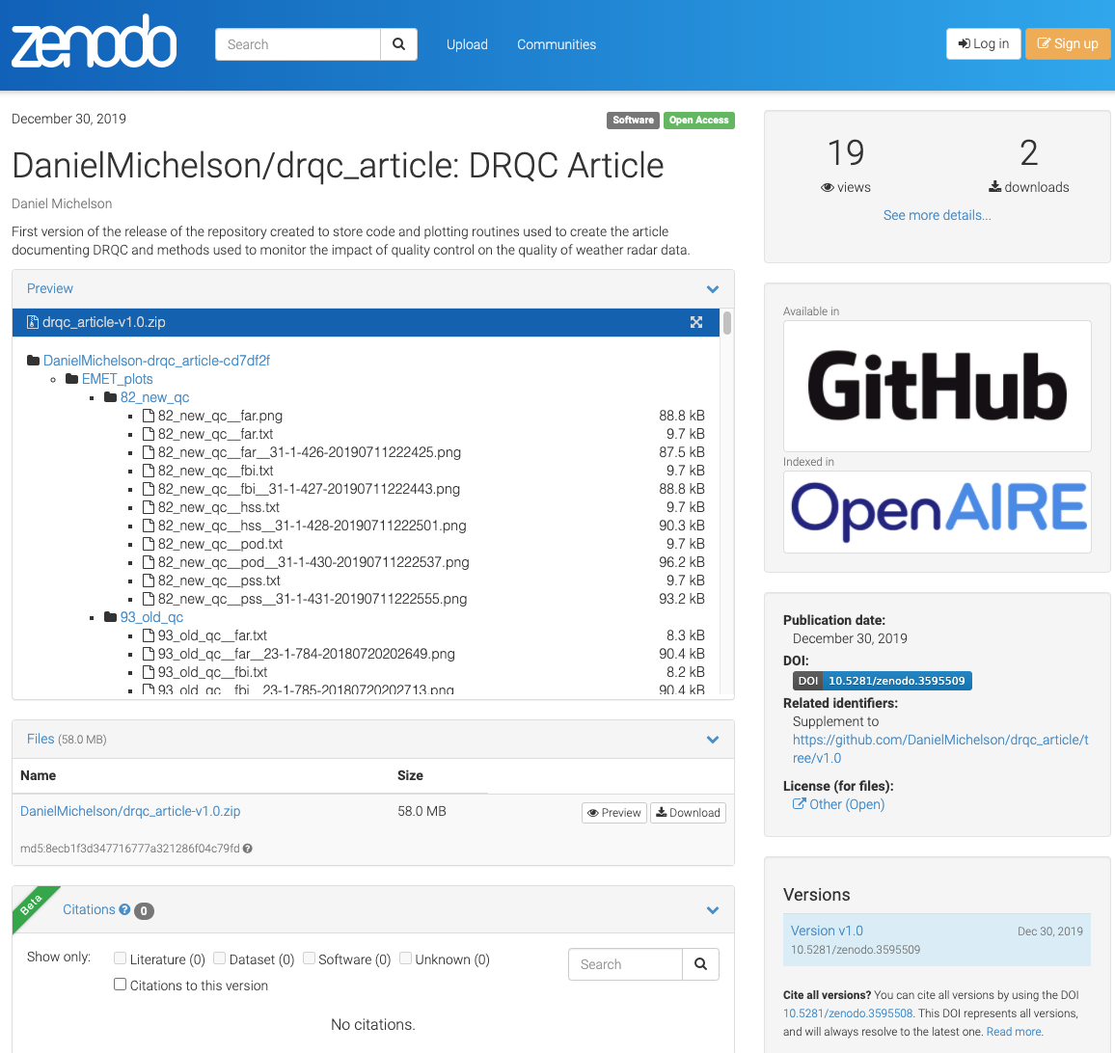
Publishing code and data for a study/paper (2/2)
Create persistent Digital Object Identifier (DOI) of the release

Slide 15
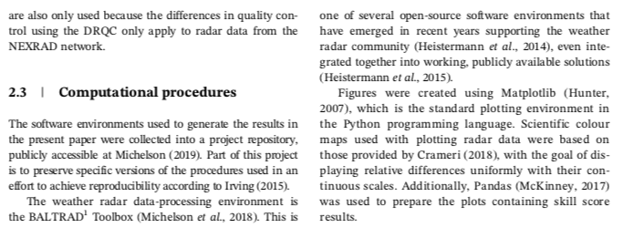

“A minimum standard for publishing…”
Create a section in the paper entitled e.g. “Computation procedures”
Add a statement describing code availability and accessibility
Refer to your DOI
Damian Irving, 2016:
A Minimum Standard for Publishing Computational Results in the Weather and Climate Sciences
https://doi.org/10.1175/BAMS-D-15-00010.1

Slide 16
Advanced pro tips: open workflows (1/2)
Same logic used to build local VM can be scaled up to HPC and cloud computing platforms
Pangeo cloud and mybinder.org are good examples: automated deployment!
Jupyter notebooks can be used to organize:
Educational material, proof-of-concept, little resources needed
Parallel cloud computing
Google Colab can run Jupyter notebooks found on GitHub.
If data are also in the cloud, e.g. NEXRAD LII radar data in AWS, then end-to-end workflows are achievable openly!

Slide 17
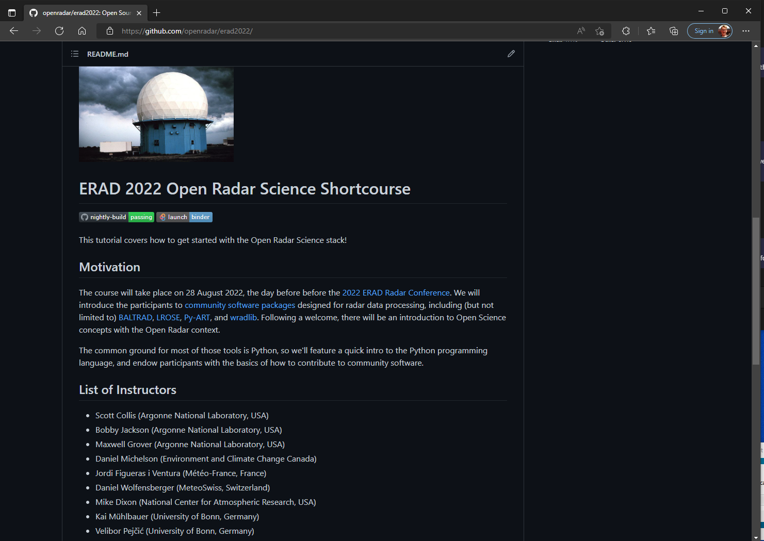
Advanced pro tips: open workflows (2/2)
Notes:
Preparing for this course earned me a Hacktoberfest 2019 t-shirt, because I submitted a certain number of Pull Requests on GitHub
Small incentive

Slide 18
Rethinking the roles of the scientific paper and scientific process
The paper:
advertises the science
provides analysis and interpretation
peer review gives it the seal of approval
The substance of the science is in the data, code and workflow
Because everything is open, transparent, & reproducible
Working technical solutions can be collaborative from the start
Innovation cycles can accelerate (COVID-19 vaccines?)
People who do the heavy lifting on preparing and publishing data and code can be potentially rewarded for it

Slide 19
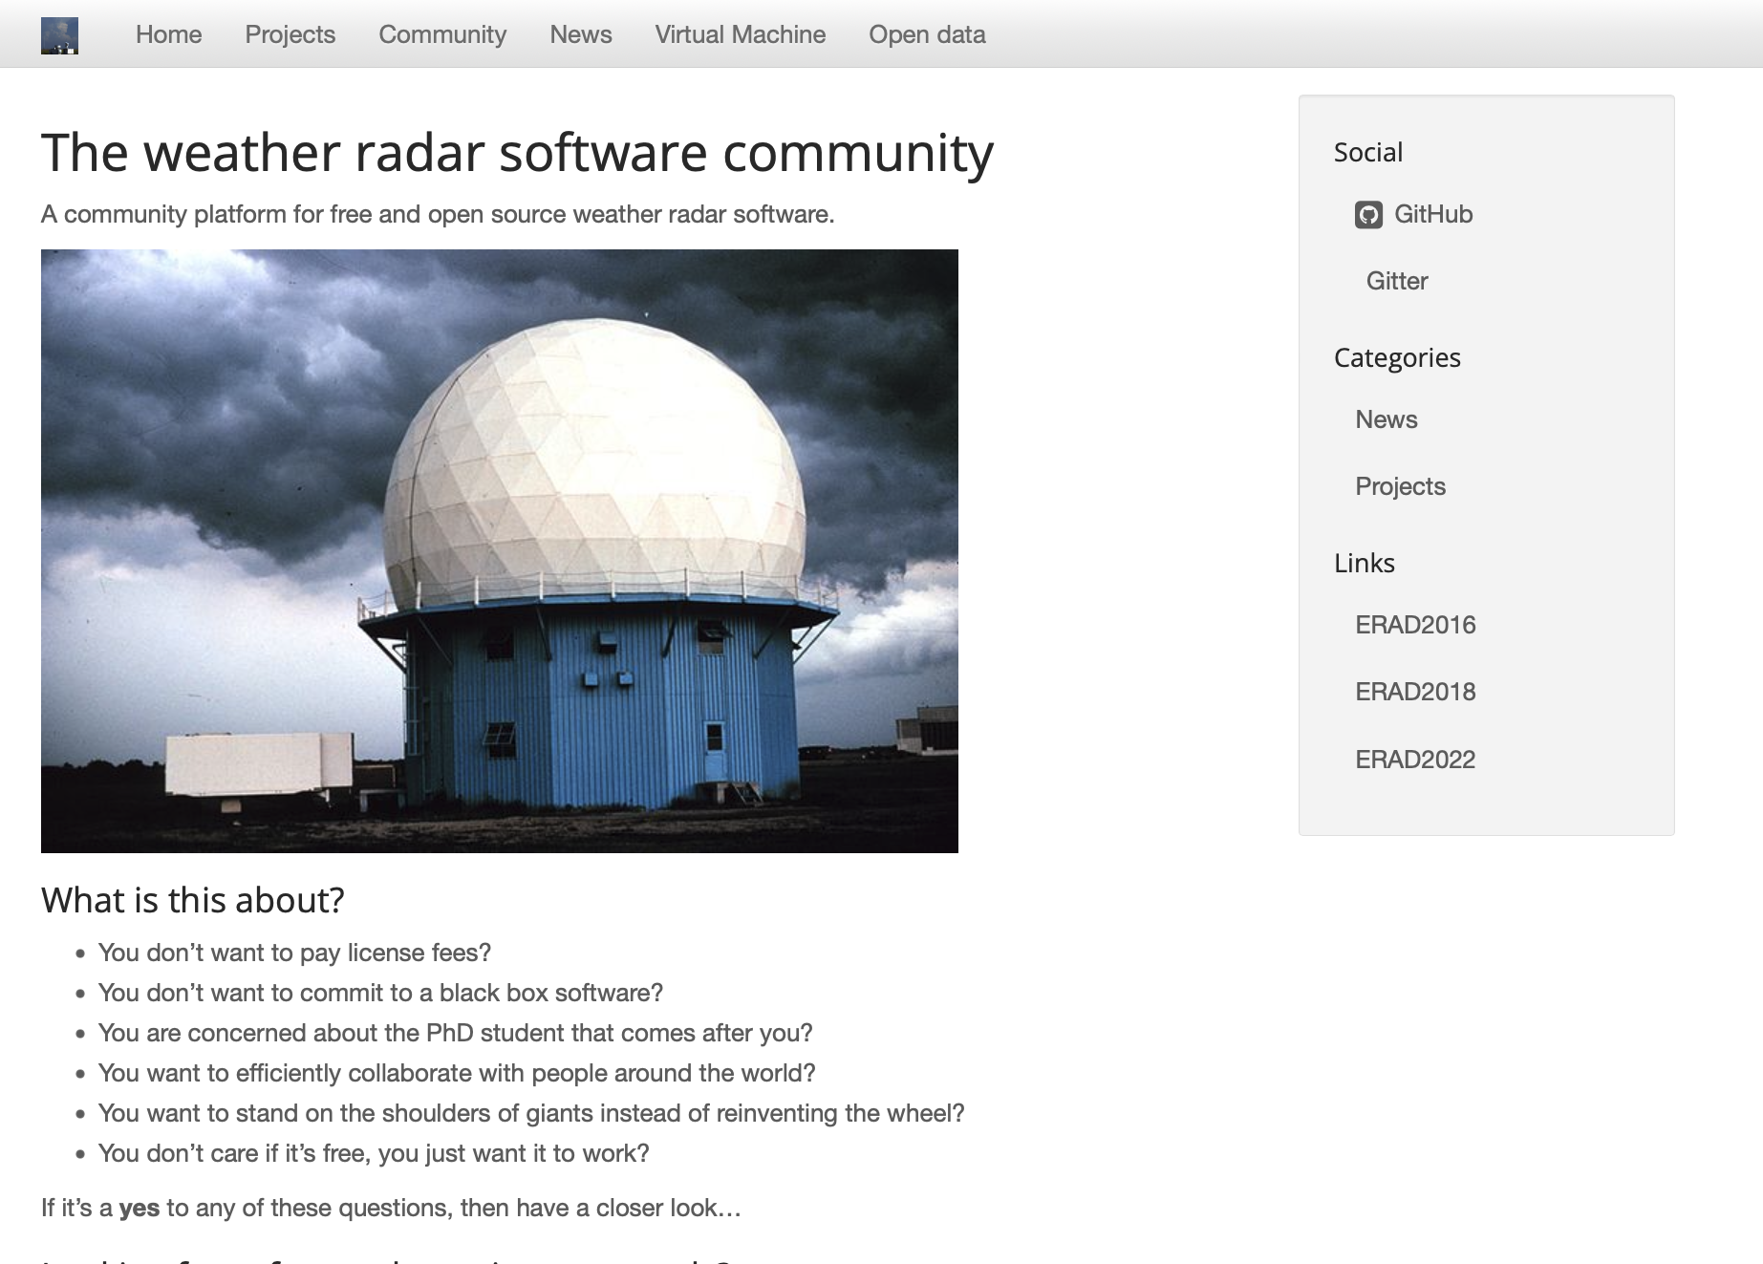
Thank you! Now Get Involved!
openradarscience.org

